Slide 1
The History of Nursing in Watauga County
Presented at
Democratic Women’s Club of Watauga County, NC Watauga County Historical Society Watauga County Public Library

Slide 2
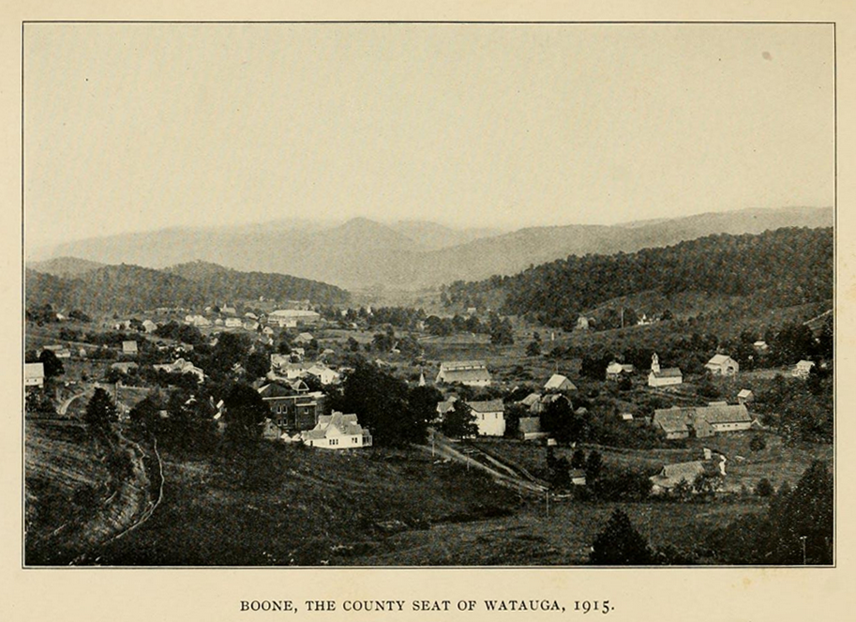

Slide 3
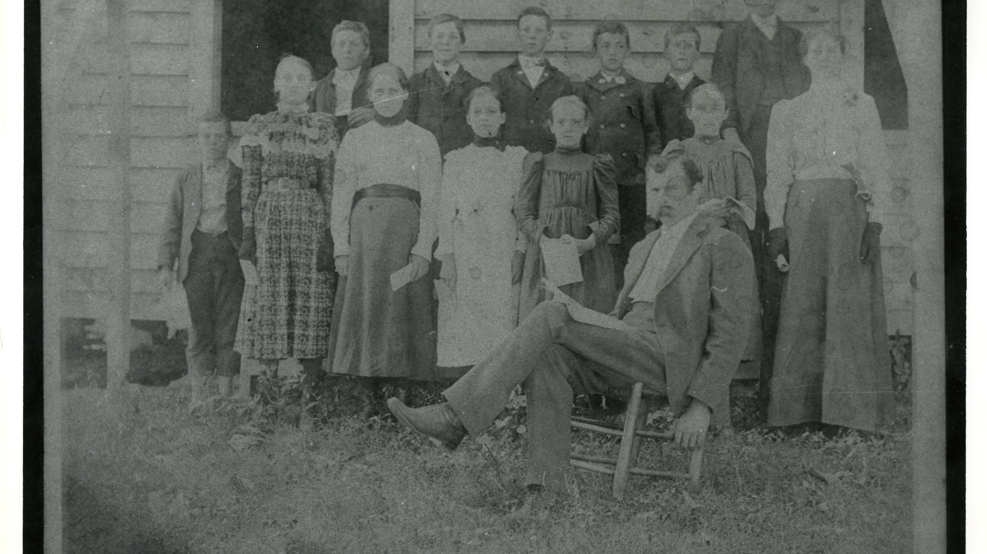

Slide 4
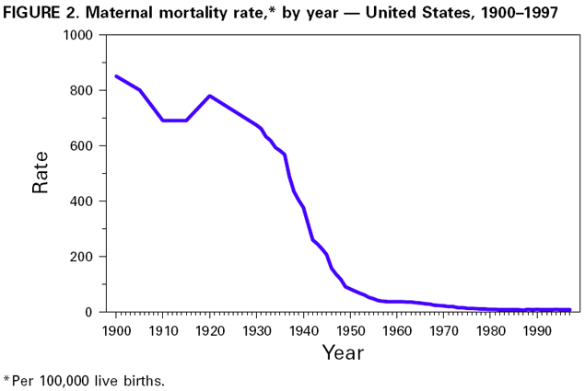
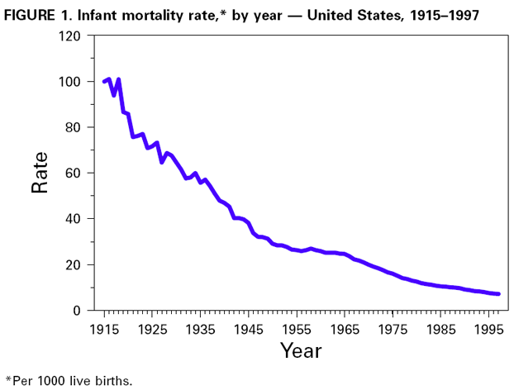
Maternal and infant mortality rates 1900-1997

Slide 5
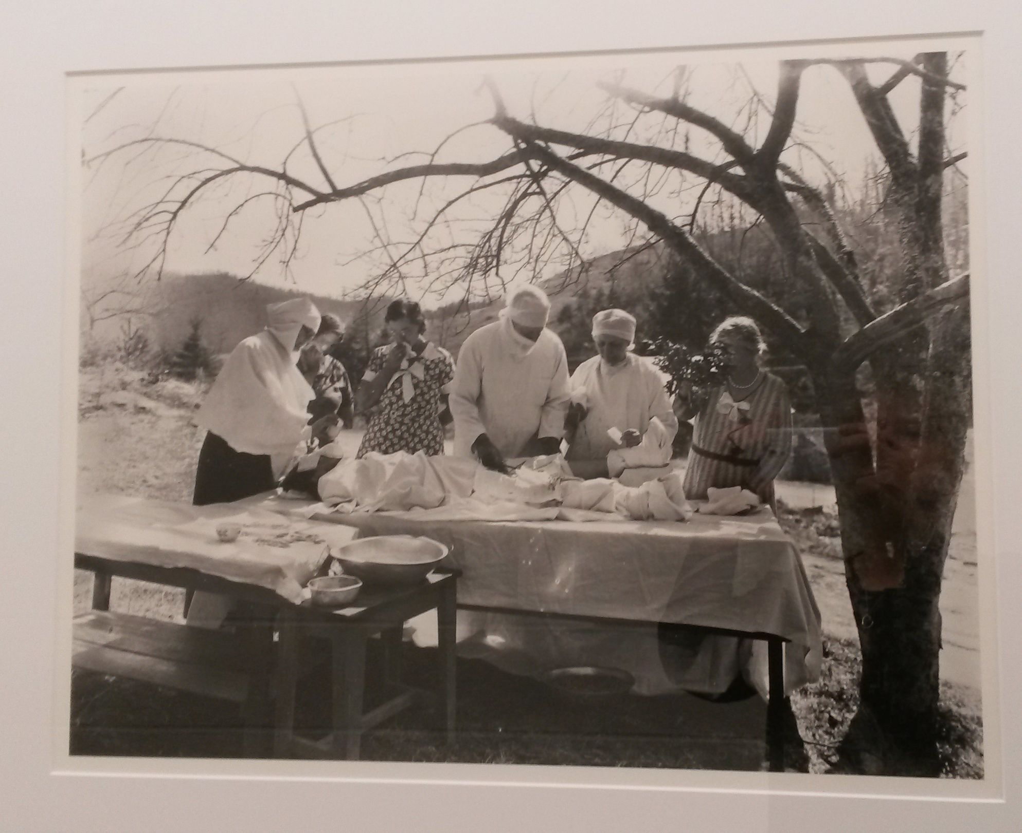
Much of the high country did not get electricity until the late 1940s so surgery and dental work were often performed outside

Slide 6
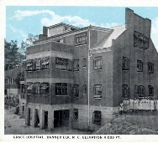
Grace Hospital (Tate Dorm), Banner Elk, NC established 1920

Slide 7
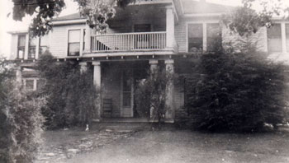
Dr. R.K. Bingham’s patients could stay over night in his home when they needed care, 1920s (Daniel Boone Inn)

Slide 8
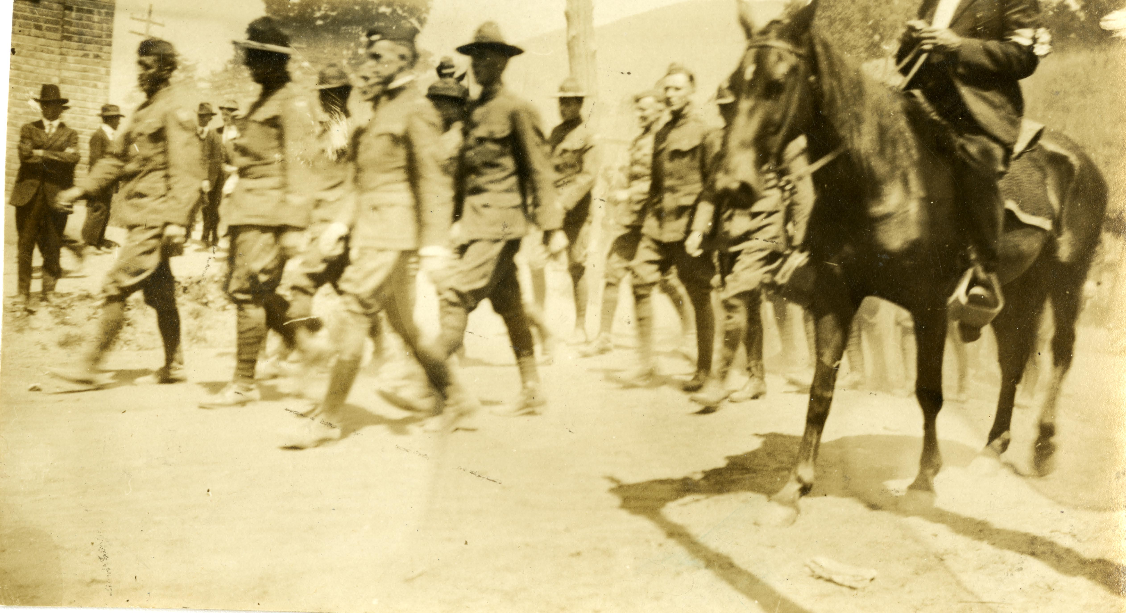

Slide 9
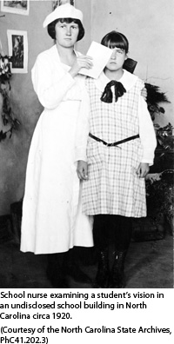
1918-1920 School children inspections

Slide 10
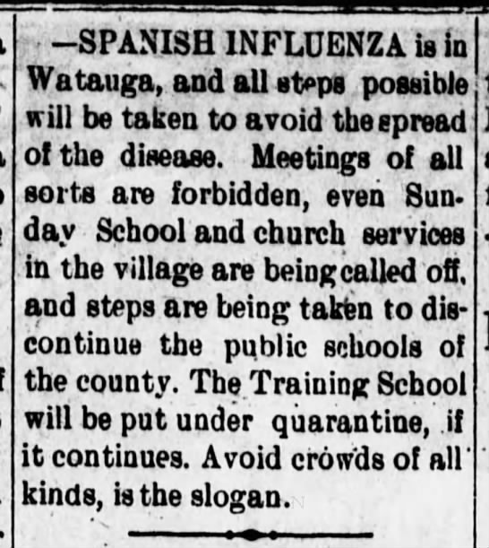
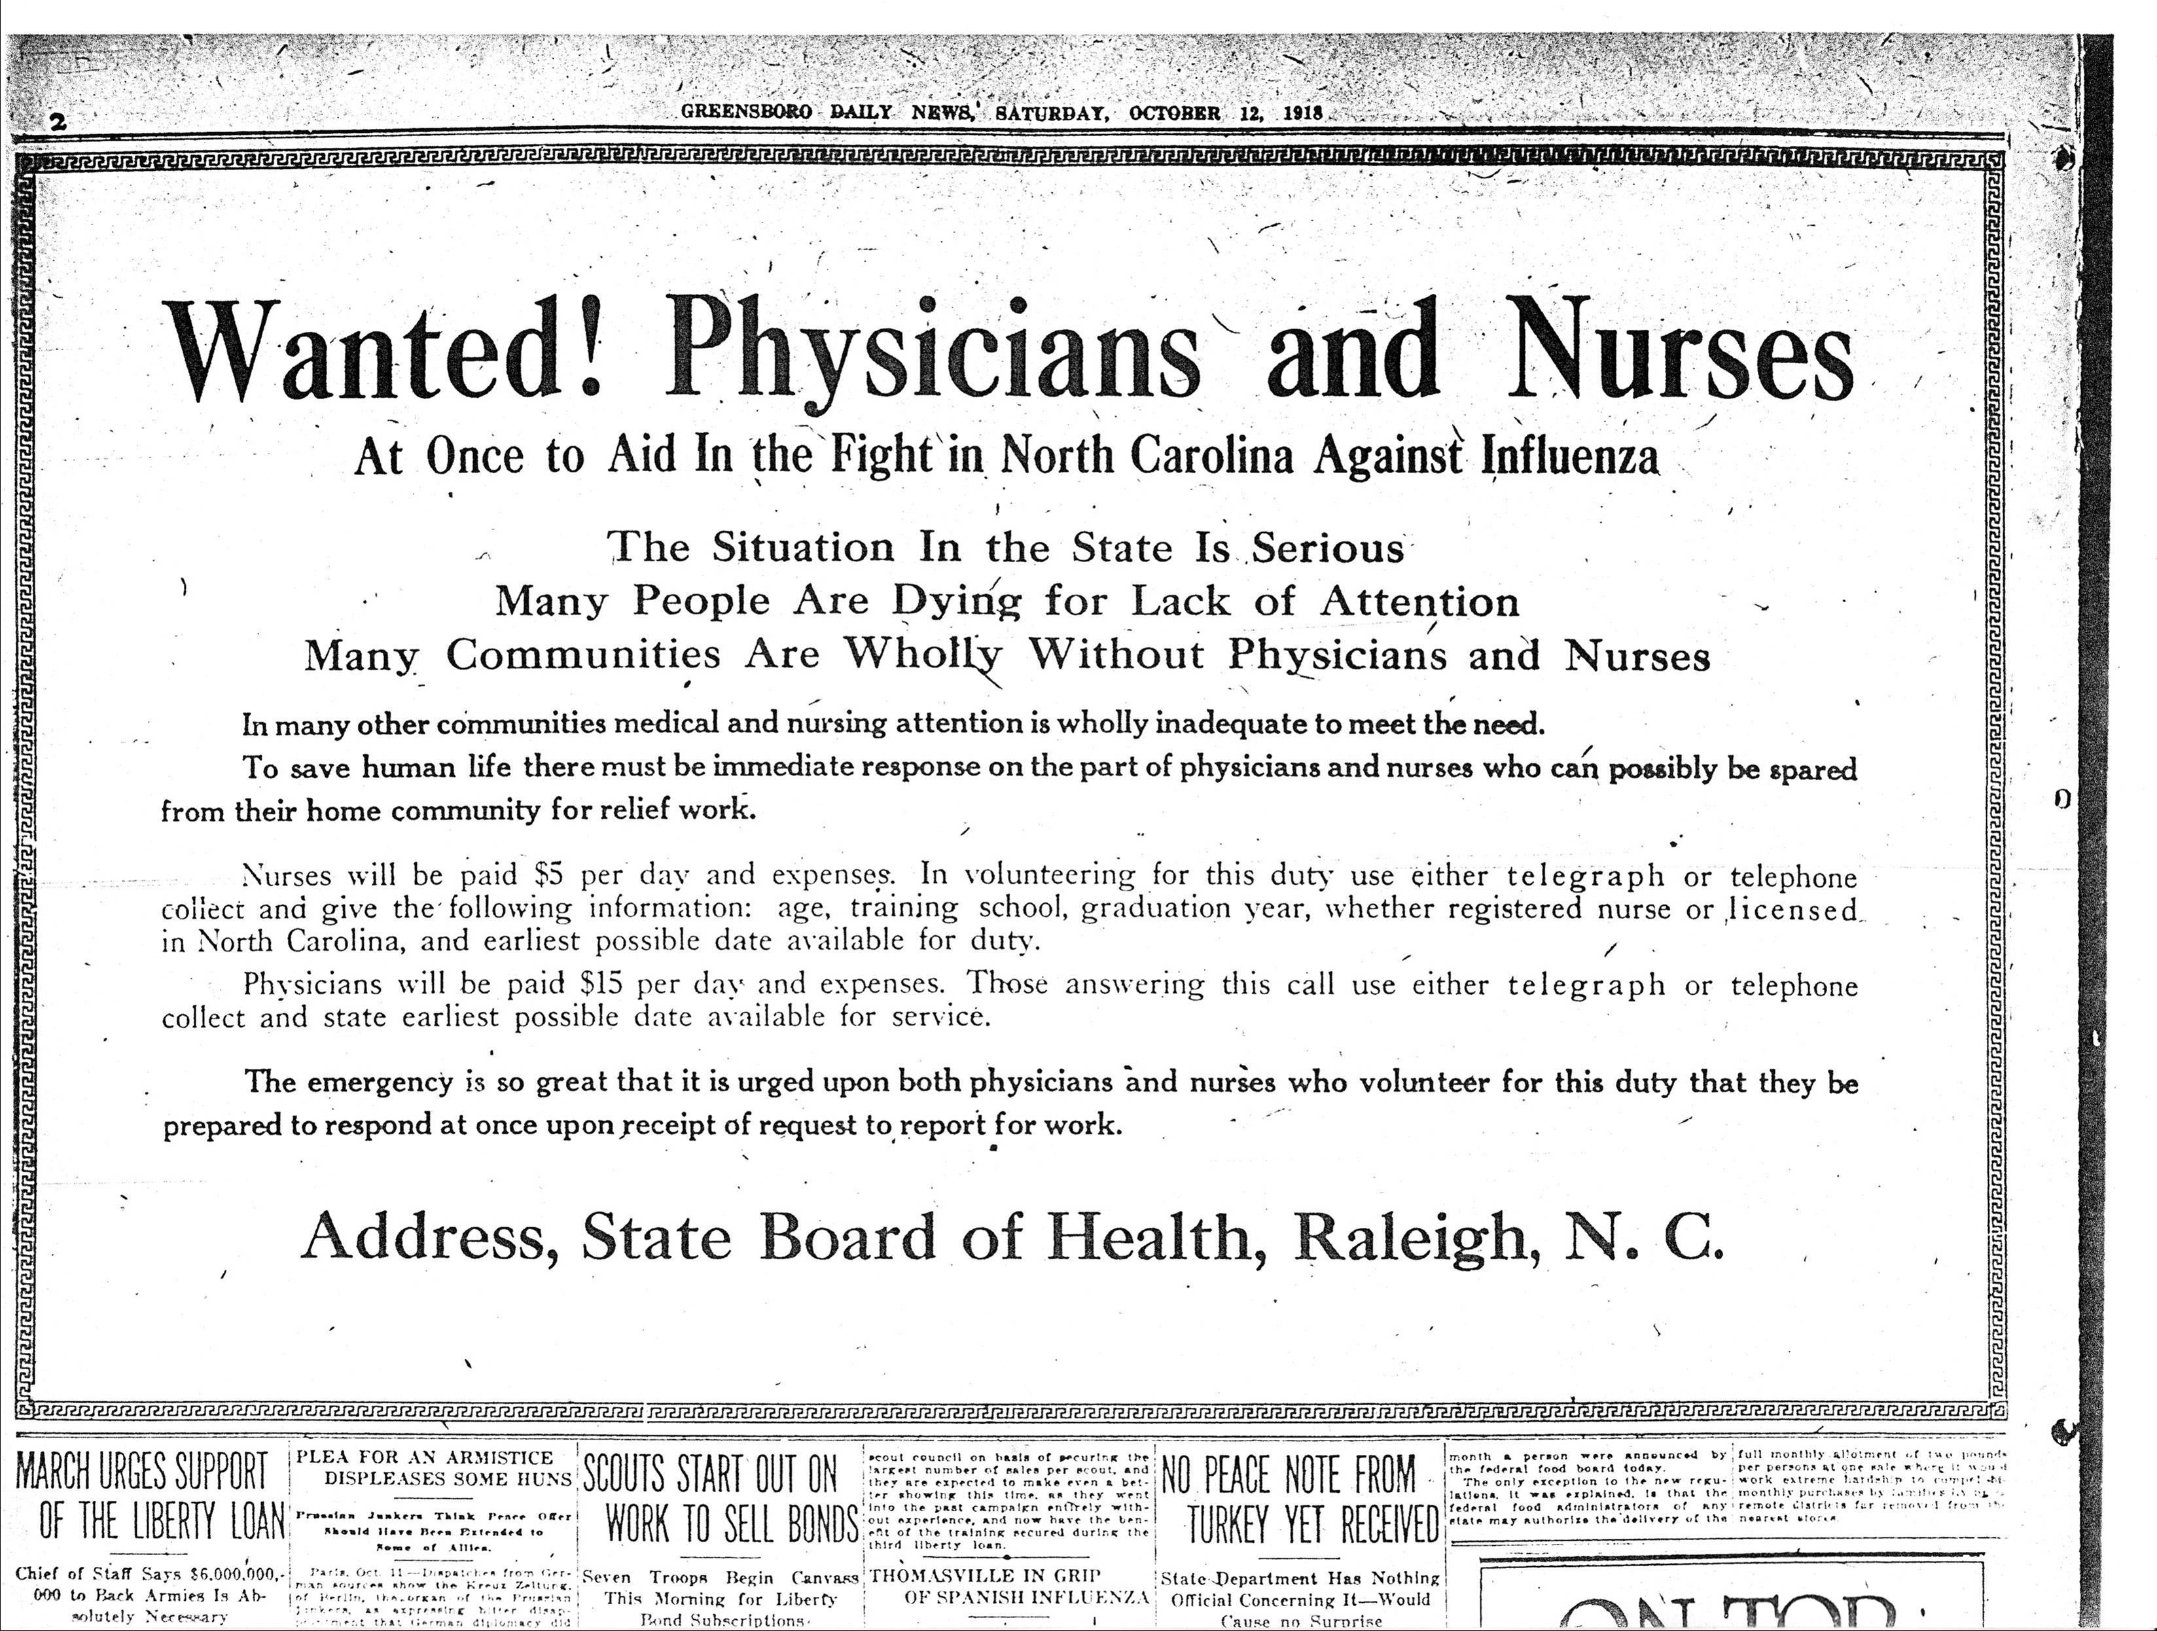

Slide 11
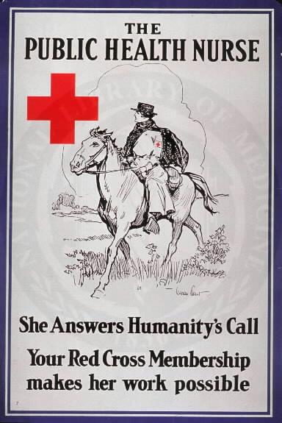
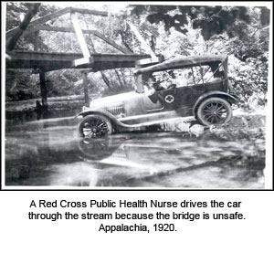
The American Red Cross became the biggest employer of public health nurses in the country

Slide 12
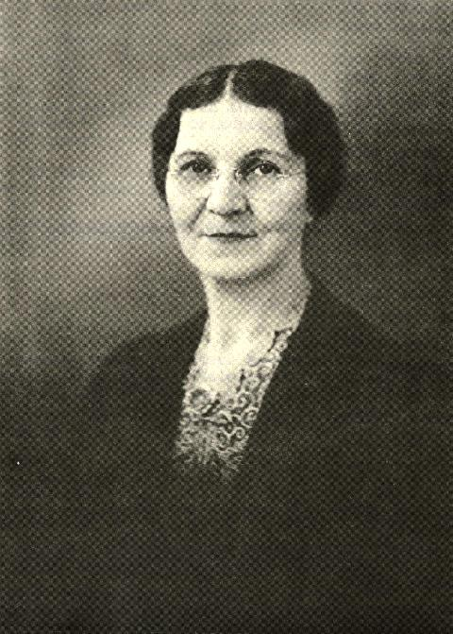
In 1920, the Watauga County Chapter of the ARC brought the first PHN to our county – Stella McCartney Hagaman.

Slide 13
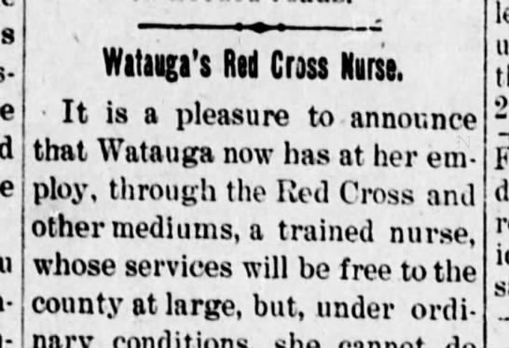
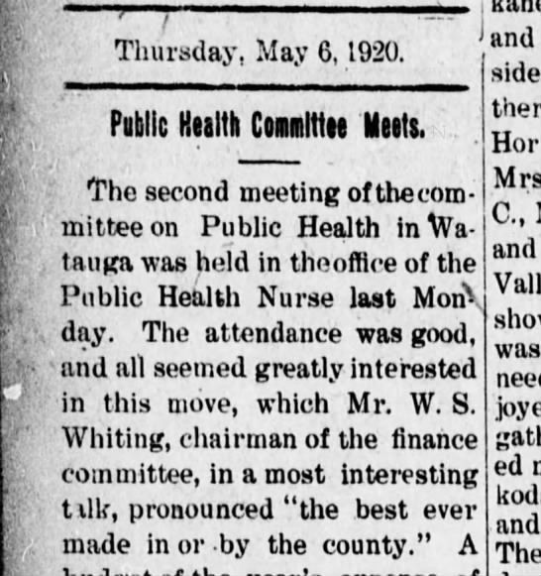
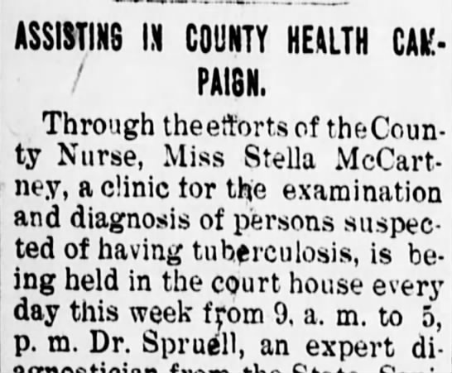
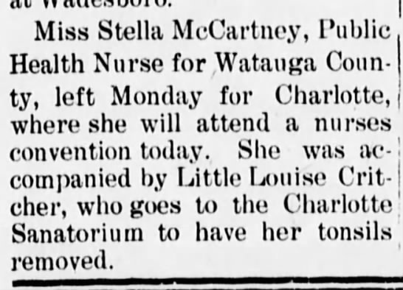

Slide 14
In McCartney’s first year (1920-21) she made:
28 home visits that required 24 hours or more 102 home visits that required less than 24 hours 301 visits to pregnant women, and/or mothers of young children 229 “sanitary visits” Visited 60 schools and with a state school nurse inspected 2,303 school children Organized clinics for smallpox vaccine and TB testing Occasionally acted as midwife and undertaker

Slide 15
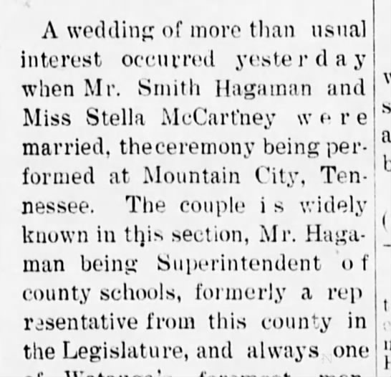
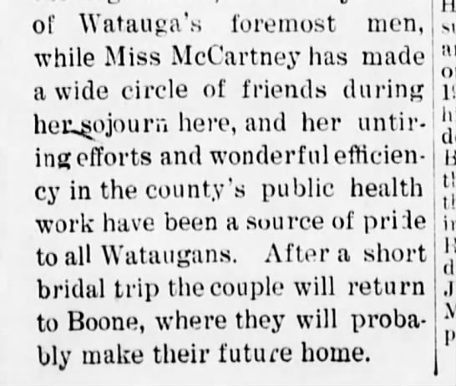
McCartney marries Smith Hagaman WD 10-6-1921)

Slide 16
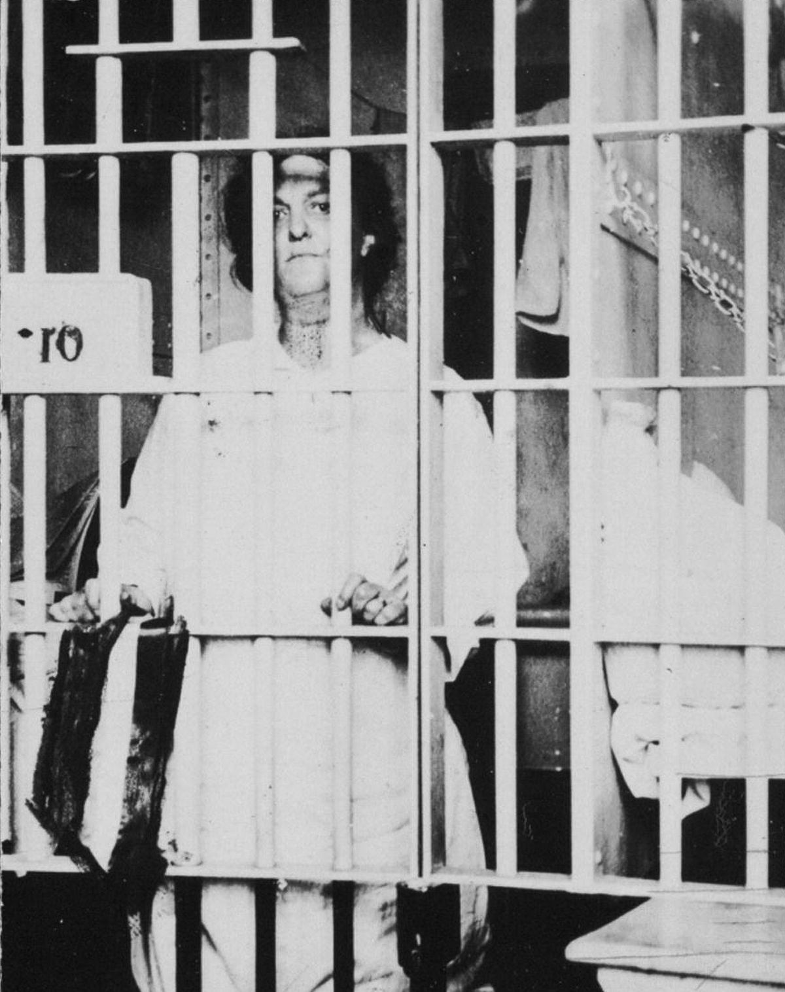
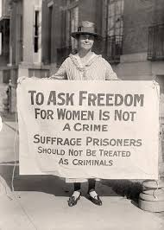
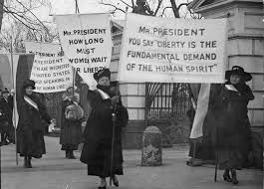
August 20, 1920 the 19th Amendment become law

Slide 17
Using their new voting power, women convinced an almost all male Congress to vote for the Shephard-Towner Act in 1921
19th Amendment passed on August 20, 1920
Women’s organizations first priority were maternal child health programs
The House passed the S-T Act 279 to 39, and the Senate passed it 63 to 7 (bi-partisan).
Republican President Warren Harding signed the legislation into law
North Carolina had 94 S-T nurses

Slide 18
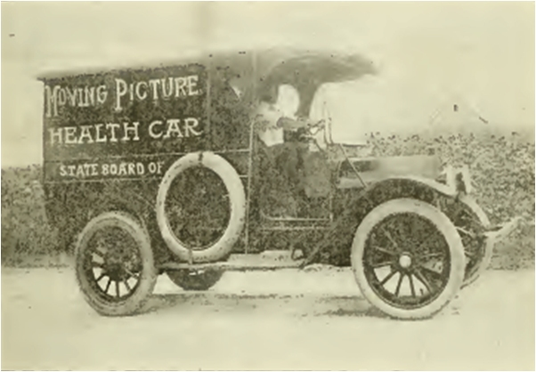
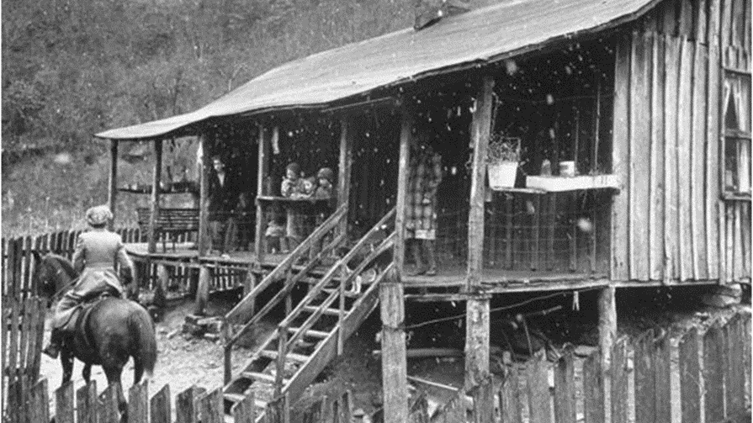
The Shepherd - Towner Acts funds provided:
Health clinics for women and children
Visiting nurses
Health education efforts focused on nutrition and sanitation

Slide 19
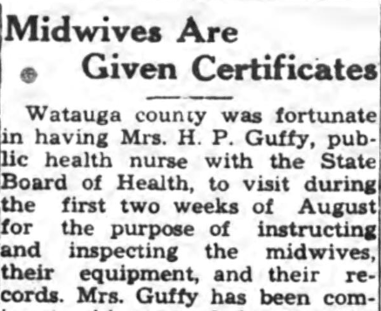
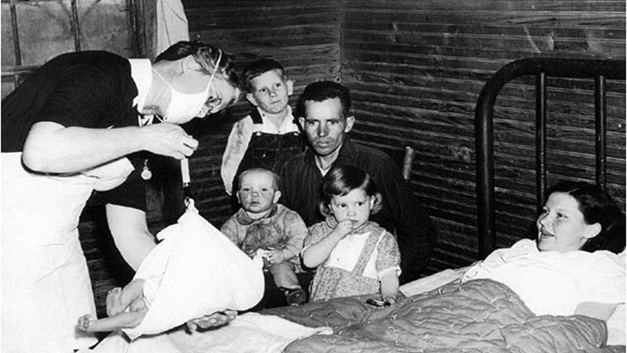
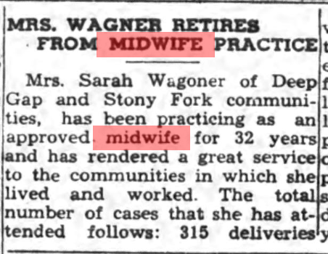
Midwife training

Slide 20
The Shephard-Towner act was repealed 1929 due to political pressure “Anti” Groups including the American Medical Association. Its Section on Pediatrics labeled the program "socialistic" and opposed its passage and opposed its funding in subsequent years. The Catholic Church also opposed it.

Slide 21
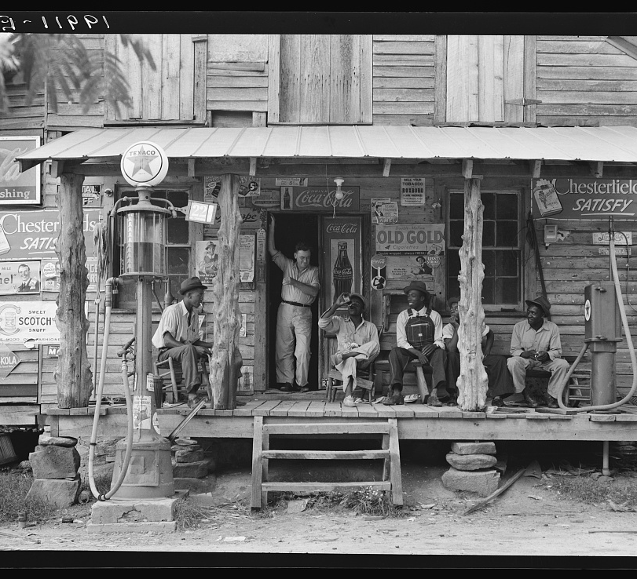
The Great Depression hit in 1929

Slide 22
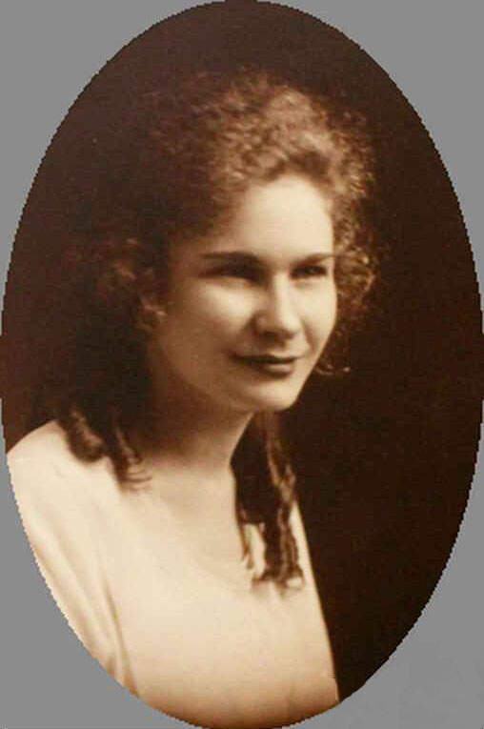
1932 – There is still no modern hospital or health department in Boone or Watauga County. Like the local Red Cross chapter a decade earlier, the Lutheran Church Mission Board hired Amy Fisher, RN, to work in the church and in the community.

Slide 23
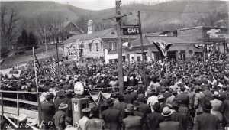
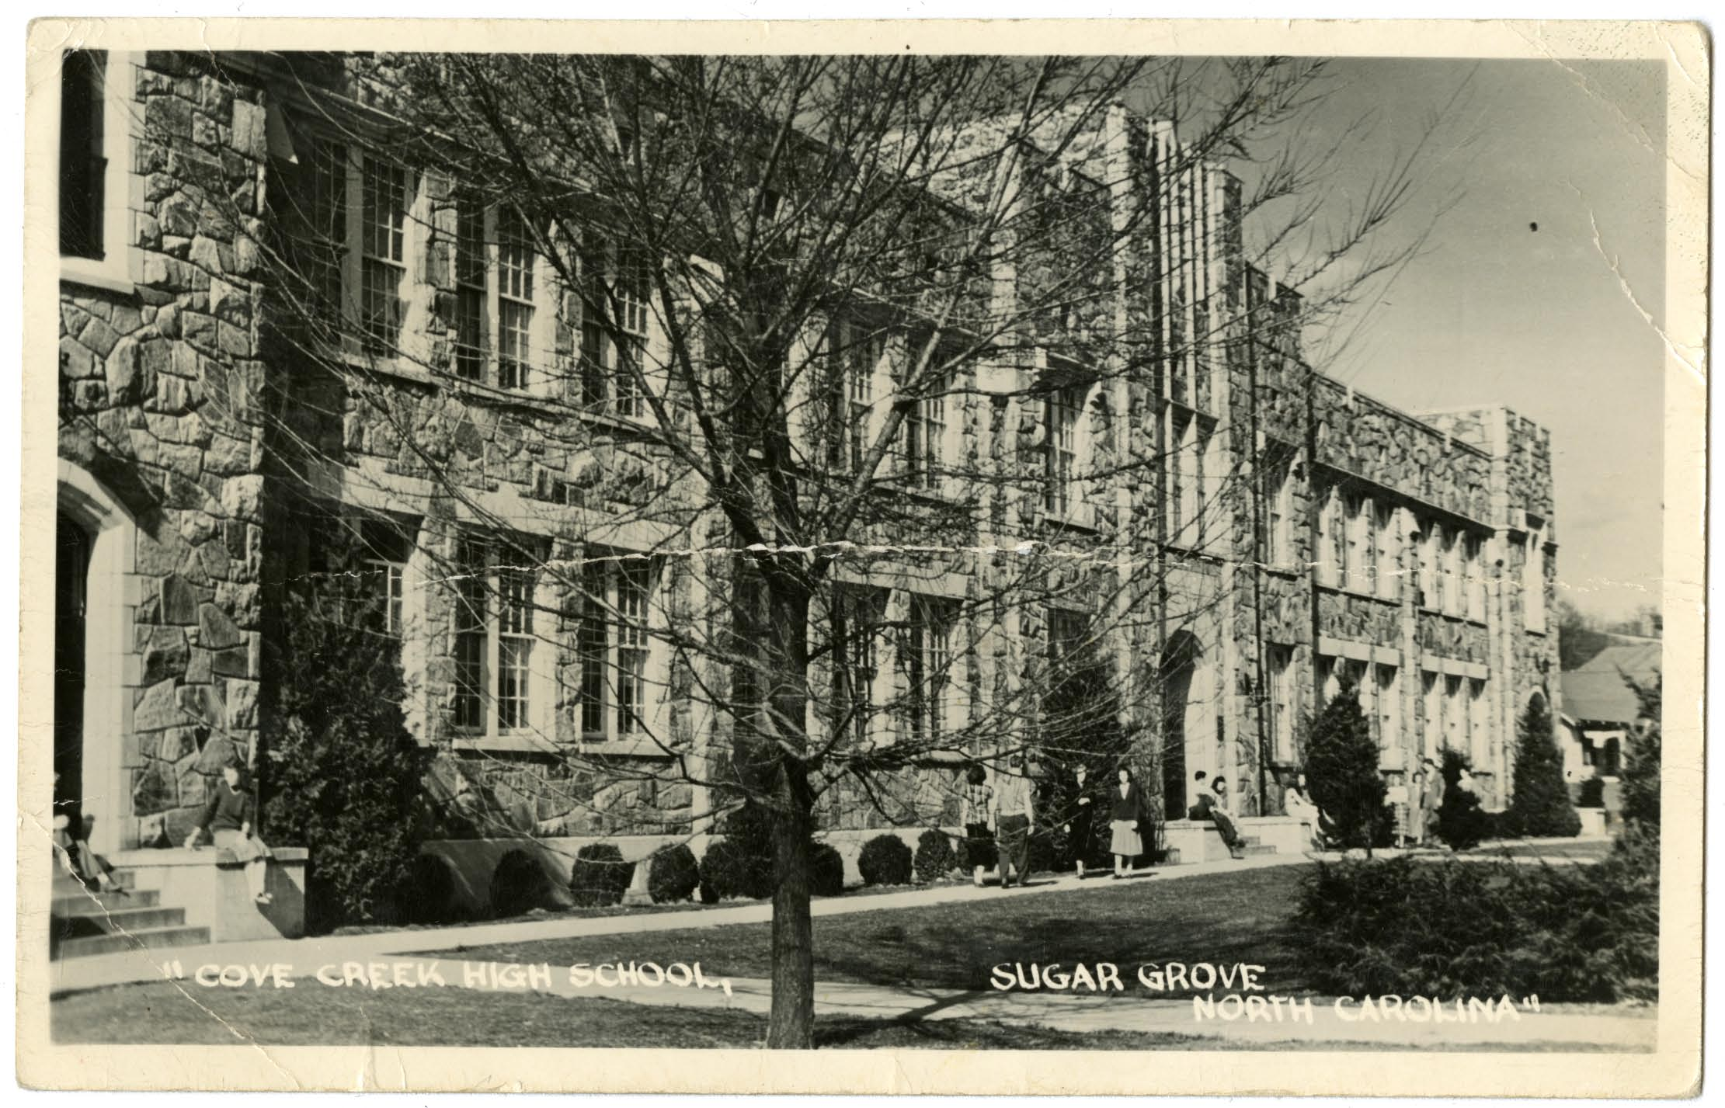
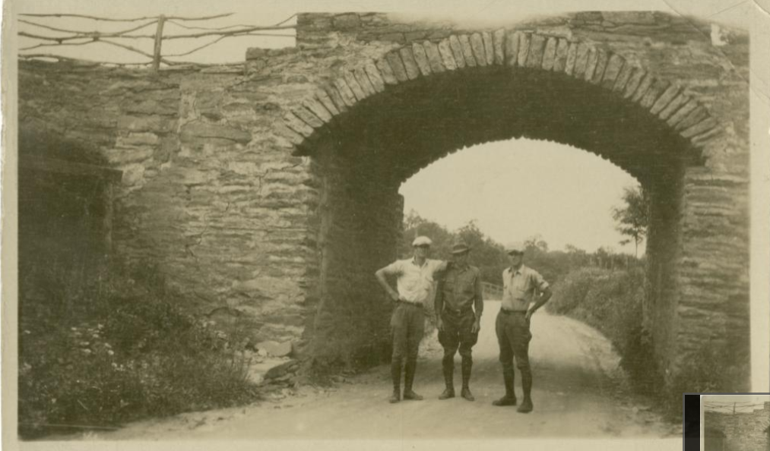

Slide 24
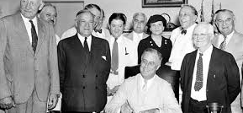
1932 - Democrat Franklin Roosevelt is elected president. He initiates many “New Deal” programs. On August 14, 1935, the Social Security Act established a system of old-age benefits for workers, benefits for victims of industrial accidents, unemployment insurance, aid for dependent mothers and children, the blind, and the physically handicapped.

Slide 25
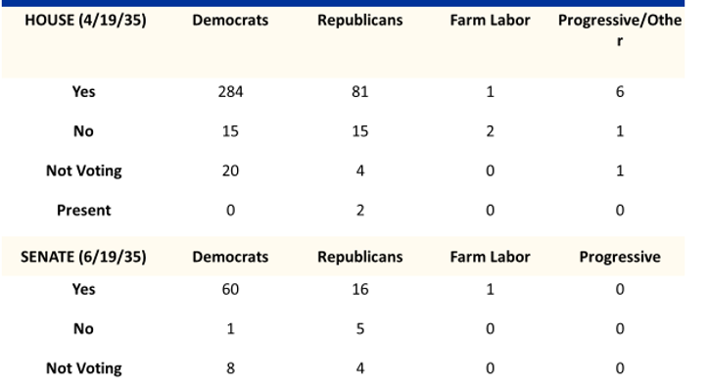
The SS Act passes easily with bi-partisan support

Slide 26
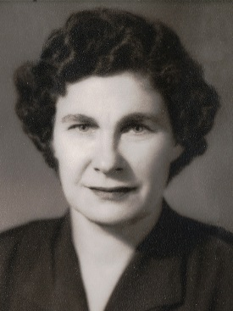
In 1935, using Social Security Administration funds, Watauga County hired Nurse Fisher as its’ first public health nurse.
Last year was the first year the health department has been in existence here and we tried to cover practically the whole county. Over five thousand people took the typhoid fever vaccine and one thousand six hundred and twenty-five babies and children were given diphtheria toxoid. The need is much too large for the individual physicians to cope with in this county, and that is why the health department does immunizations on such a large scale.
There are about fifty schools in the county, and we plan our schedule so that we may get to the most inaccessible ones before bad weather sets in. But even then we sometimes have to walk part of the way. We don’t try to go to Lower Elk after a hard rain because you ford the creek twenty-two times and some of the fords are pretty deep.

Slide 27
Show movie
https://www.criticalpast.com/video/65675023109_Health-care-in-Appalachia_Nurse-Amy-Louise-Fisher_tooth-extraction_vaccination

Slide 28
Using some New Deal funds, Watauga County Hospital opened Easter Sunday, April 7, 1938. There were 37 beds, and 3 nurses. It is the first hospital in the county.
Mr. Smith Hagaman, husband of Stella McCartney Hagaman was the Chairman of the Hospital Board of Directors

Slide 29
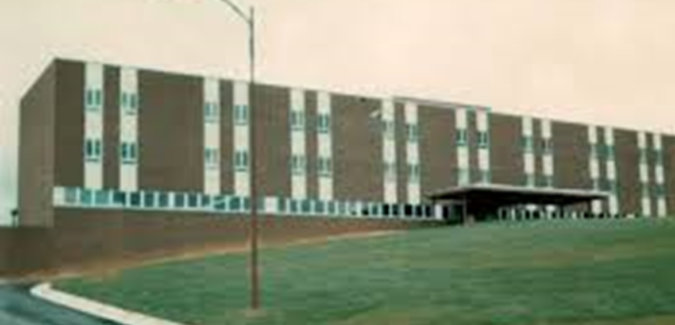
1945 - Democratic President Harry Truman proposed a universal health insurance coverage plan, administered and paid for by a National Health Insurance Board. Opponents of the proposal, including the American Medical Association, decried it as "socialized medicine," and the bill died in Congress.
However, the Hospital
Survey and Construction Act
(commonly known as the
Hill-Burton Act) was passed
by Congress in 1946.
The “new” WMC was built
using some Hill Burton funding
in 1968

Slide 30
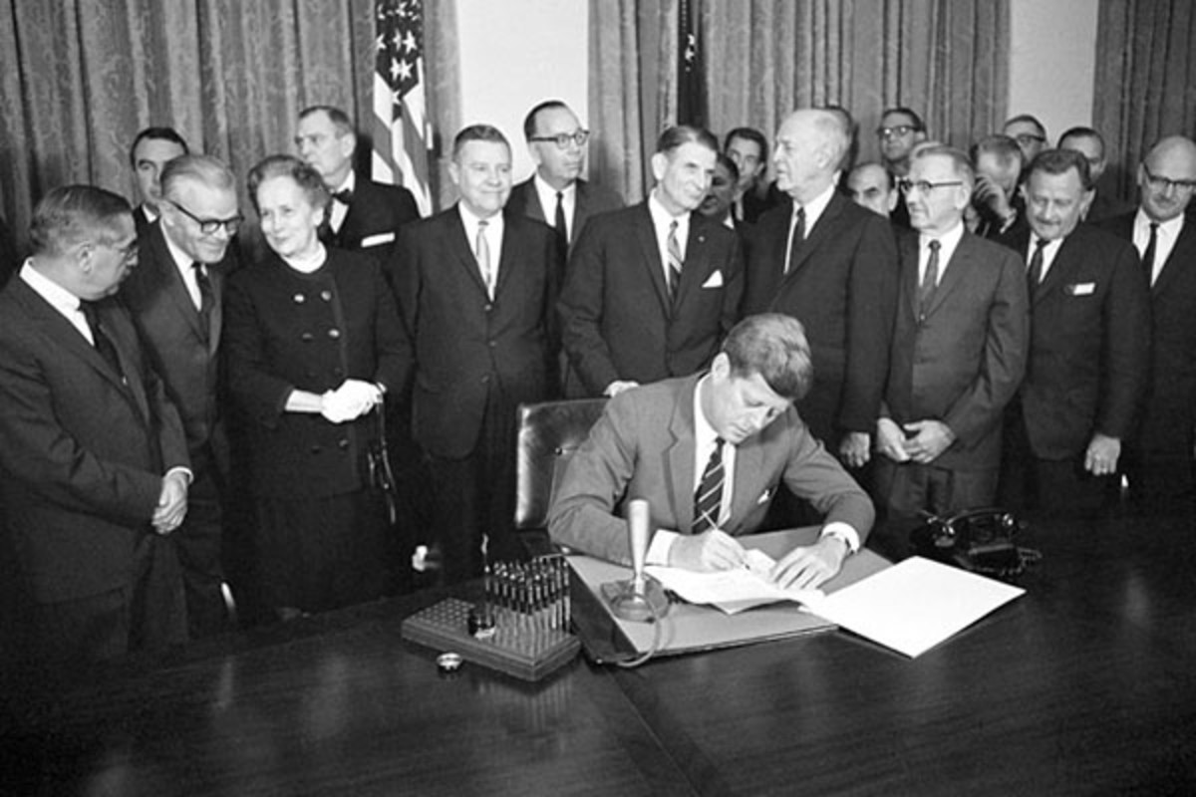
Democratic President John F. Kennedy signs the Community Mental Health Act into law on October 31, 1963.
All Votes |  | Democrats | Republicans
Yea | 69% | 299 | 180
Nay | 3% | 13 | 7
Present | 27% | 116 | 67
Not Voting | 1% | 4 | 2

Slide 31
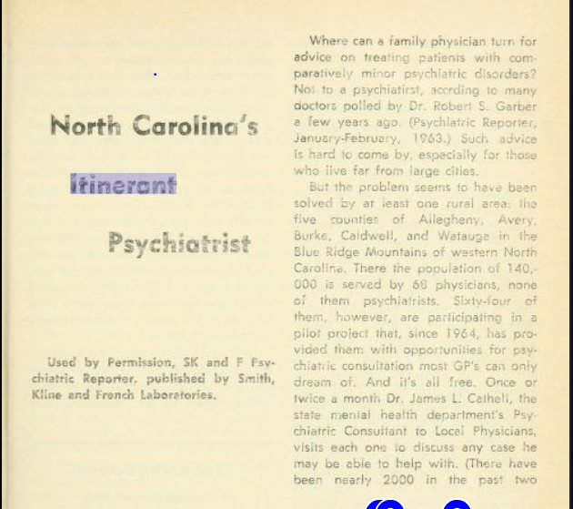
New River Mental Health opens in mid 1960s using CMHA funds

Slide 32
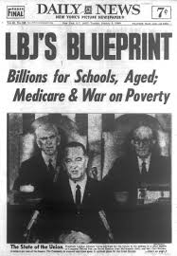
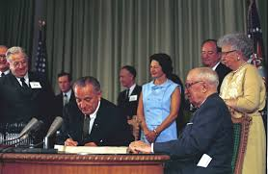
1964 - Democrat Lyndon Johnson is elected President and starts “Great Society” programs including Medicare and Medicaid which pass Congress in 1965

Slide 33
Democrats overwhelmingly support Medicare/Medicaid, Republicans are divided

Slide 34
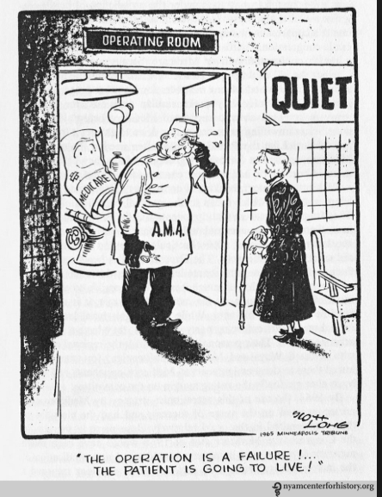
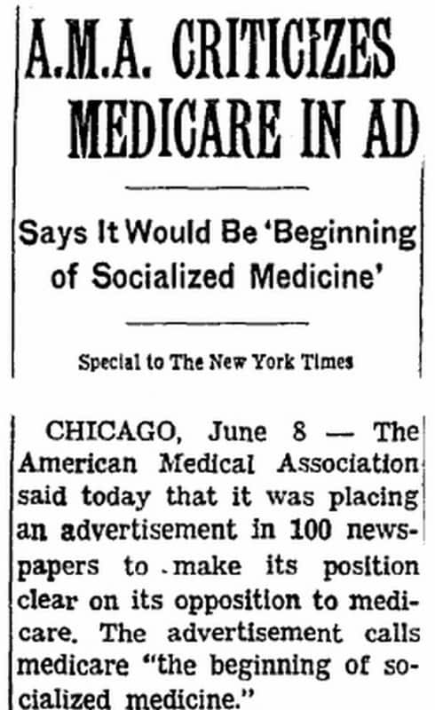
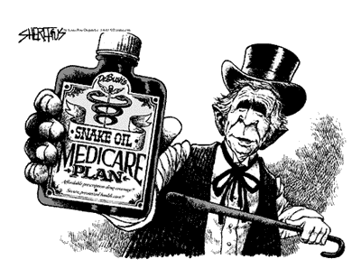

Slide 35
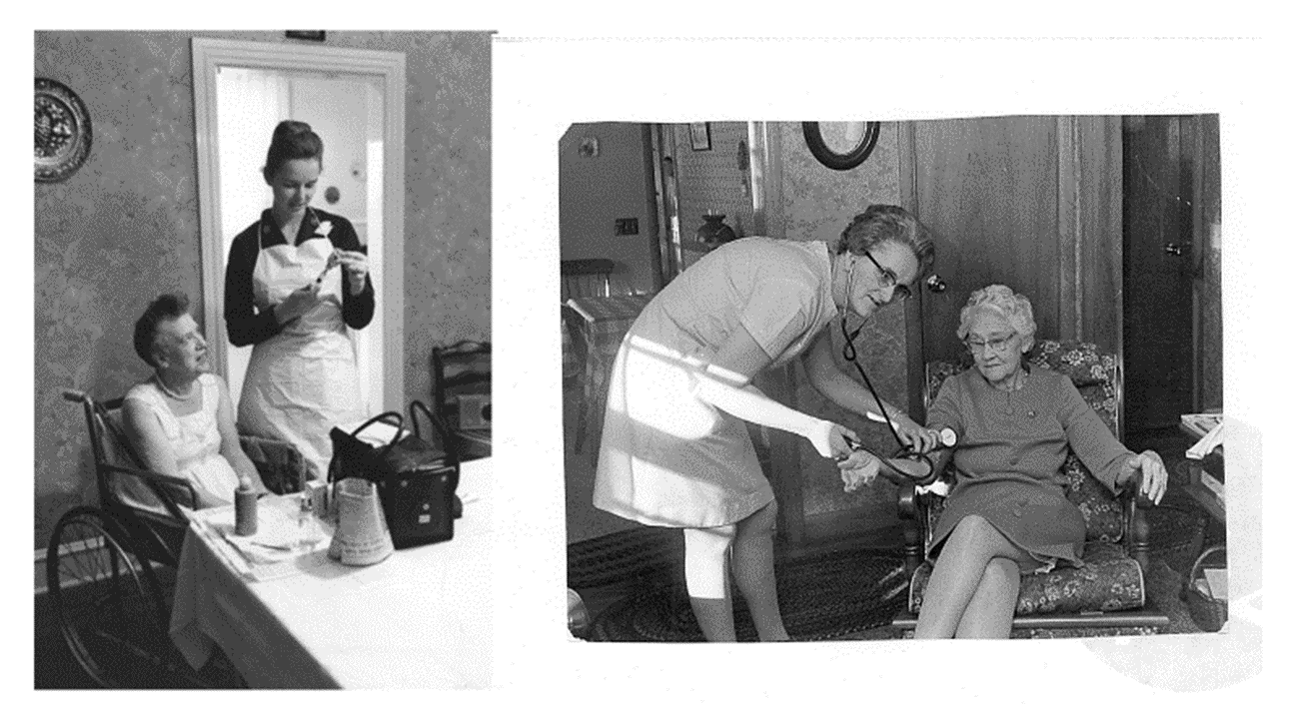
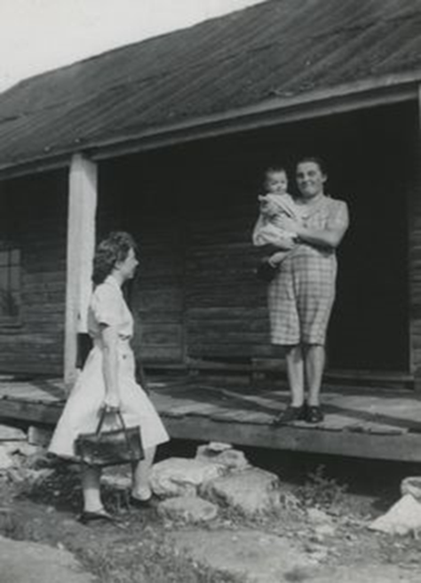
These programs fund home health care, hospice care, maternal/child home visits, child health, STD and family planning clinics and more.

Slide 36
Immunization clinic at the Watauga County Health Department

Slide 37
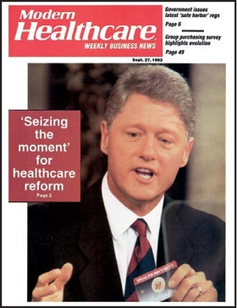
In 1993, Democratic President Bill Clinton proposed a health care reform plan much like the ACA. It never got a vote in Congress.

Slide 38
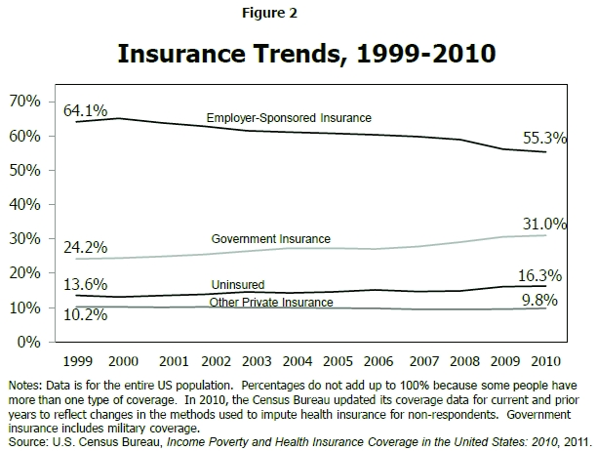
Uninsured increased by 9 million people 1999-2010

Slide 39
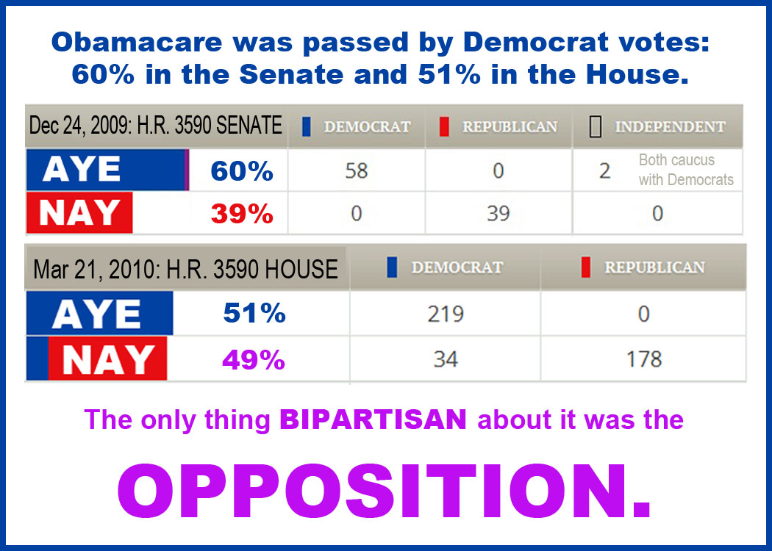

Slide 40
President Obama signing the Affordable Care Act into law March 23, 2010Pre2010sident Obama signi20ng the AfforPresident Obama signing the Affordable Care Act into law March 23, 22010- Democratic President Barak Obama signs the Affordable Care Act2010- Democratic President Barak Obama sig2010nare Act010dable Care Act into law March 23, 2010
March 23, 2010 – Democratic President Obama signs the AC Act

Slide 41
Some benefits of the ACA
Protects people with pre-existing conditions from being denied health insurance
Young people are guaranteed coverage on their parents’ health plans until they are 26
Expansion of health coverage to low-income families through the Medicaid program in 33 states
Requires that most health plans cover preventive care—like cancer screenings, vaccines, birth control, blood pressure tests and more—at no additional cost.
Millions more people have coverage for mental health and substance use disorder services.
Eliminates lifetime and annual coverage limits

Slide 42
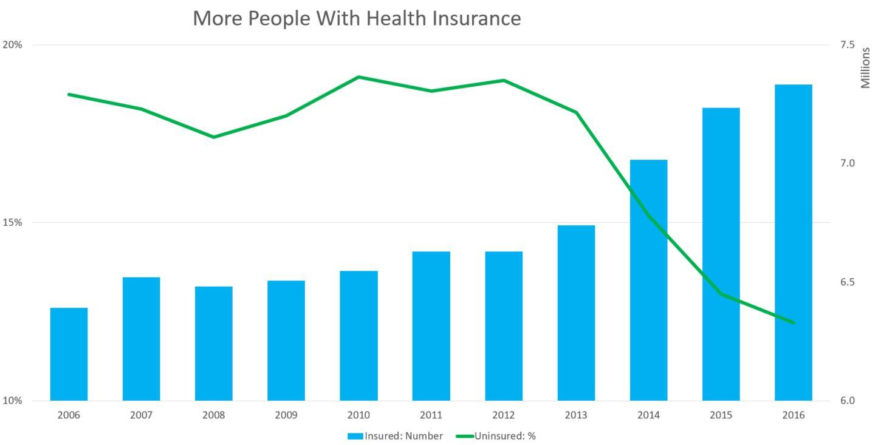
What is next???

Slide 44
What does the future hold? Medicaid expansion? Medicare for all? Will the Republican Party join in any health care reform?

